Slide 1
Smart Home Automation
CEIS101 Final Course Project
CEIS101
Isis Autry
Prof. Aaron Marmorstein

Slide 2
Introduction
The Course Project was meant to make a prototype smart home automation system. We were to add a light sensor, motion sensor, as well as a door sensor. We used the site TinkerCAD and the project guide to be able to execute this project.

Slide 3
Delete this slide after completing requirements
Copy and paste all projects that were assigned throughout this session. Please note that this is your chance to improve them or complete them if you have not before.
Delete the rubrics.
Optional: Provide brief summaries at the end of each project as transition slides or describe the objectives of each project

Slide 4
CEIS101
Module 2
Circuit Simulation in Tinkercad

Slide 5
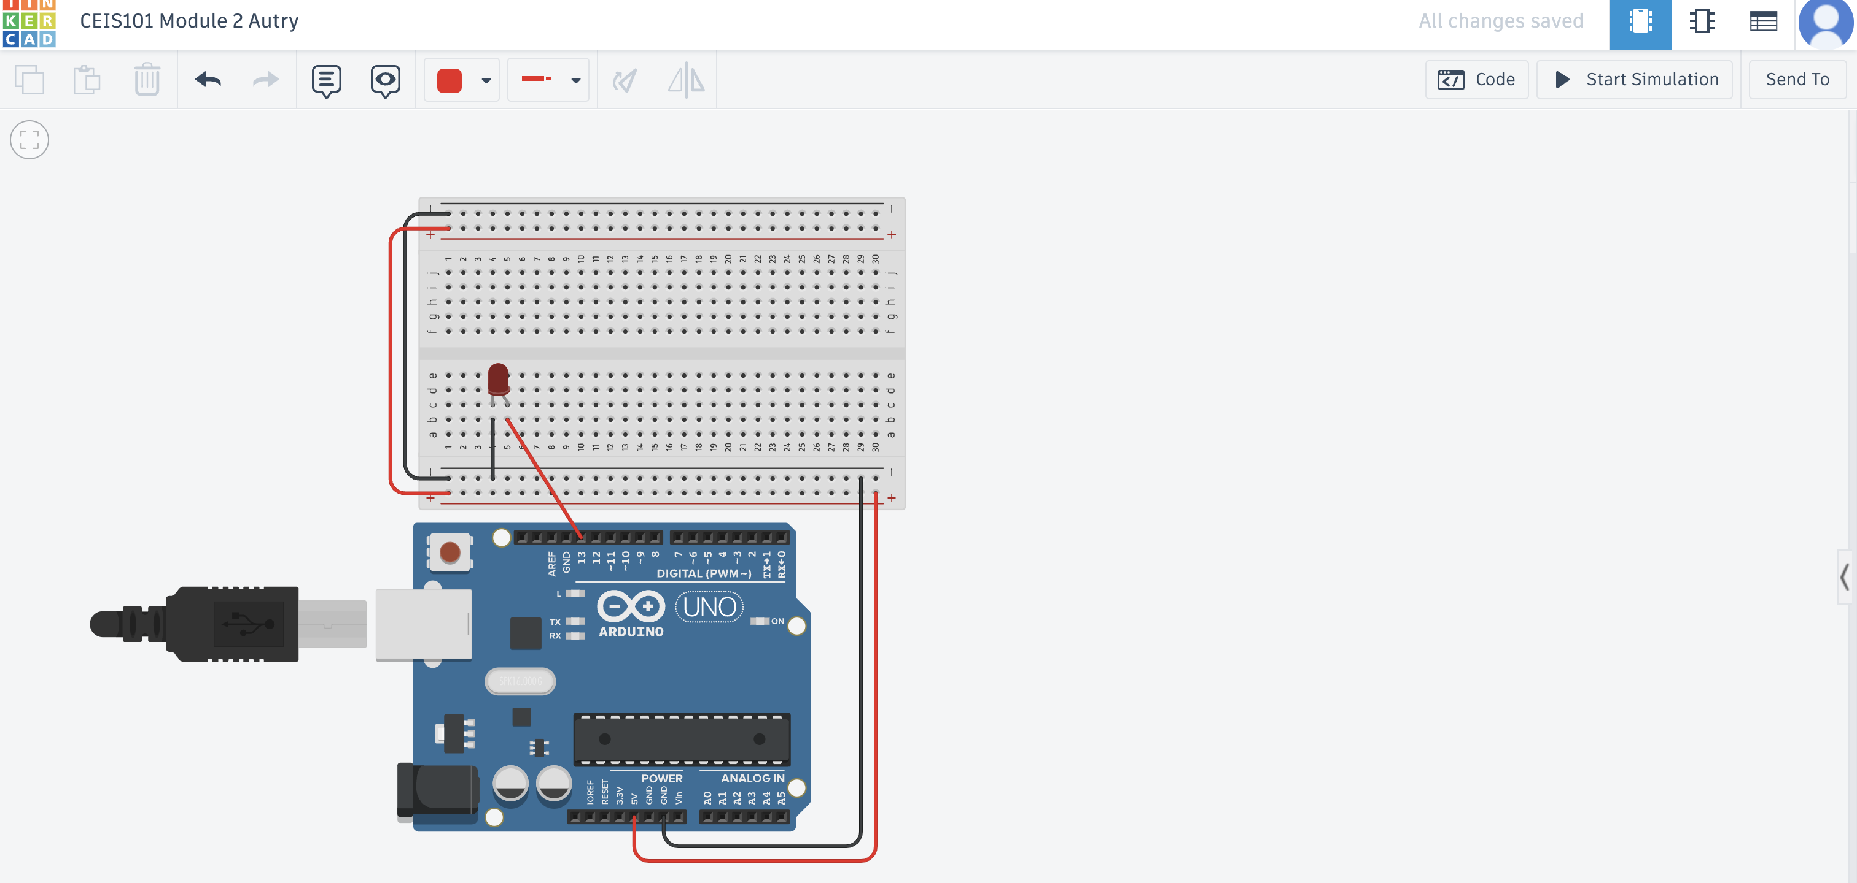
Circuit (screenshot)

Slide 6
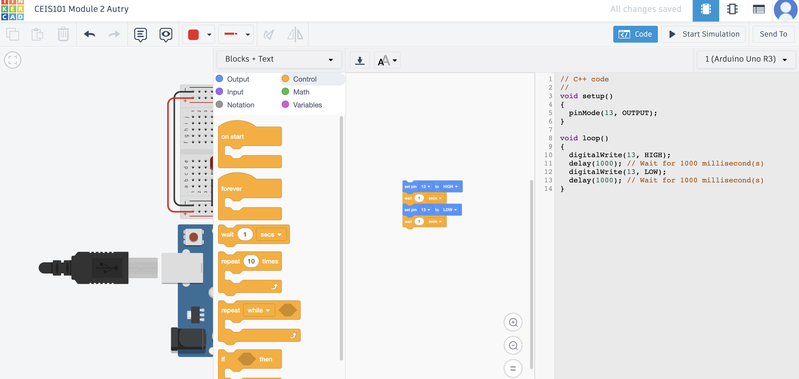
Code (screenshot)

Slide 7
CEIS101
Module 3
Inventory of Parts, Circuit Building, and Displaying Messages

Slide 8
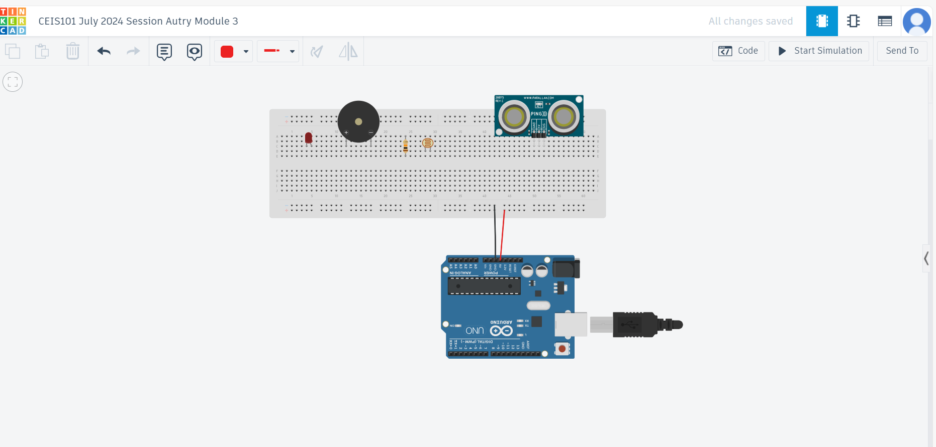
Organization of Project Components (picture)
Arduino Uno
Breadboard
Resistor 10kΩ
LEDs
Ultrasonic Sensor
Active Buzzer
Photoresistor
Wires

Slide 9
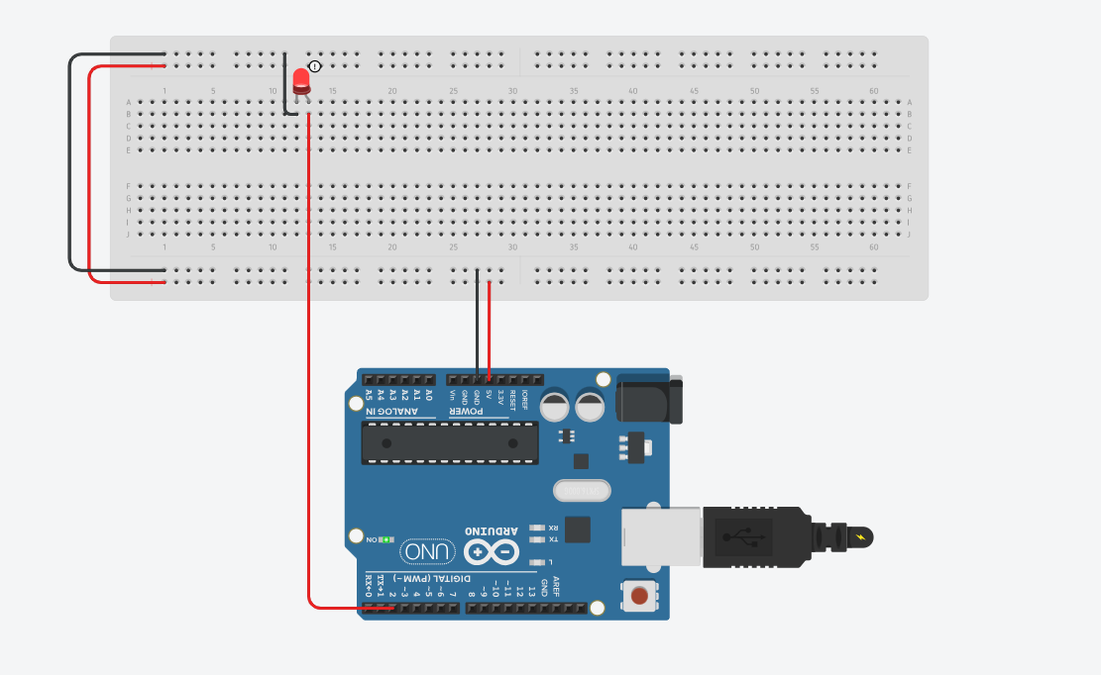
Circuit with red LED on (picture)

Slide 10
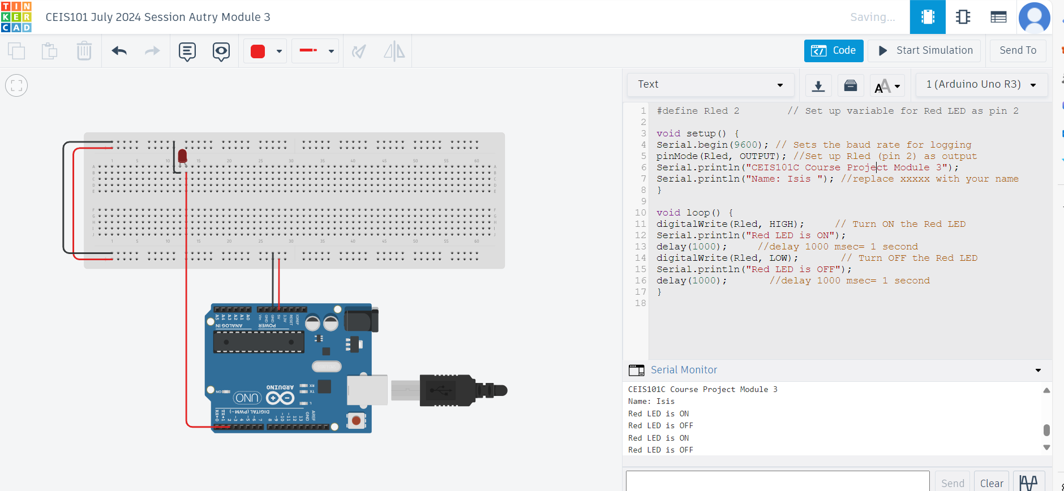
Serial Monitor (screenshot)

Slide 11
CEIS101
Module 4
Adding Door Sensor to Smart Home System

Slide 12
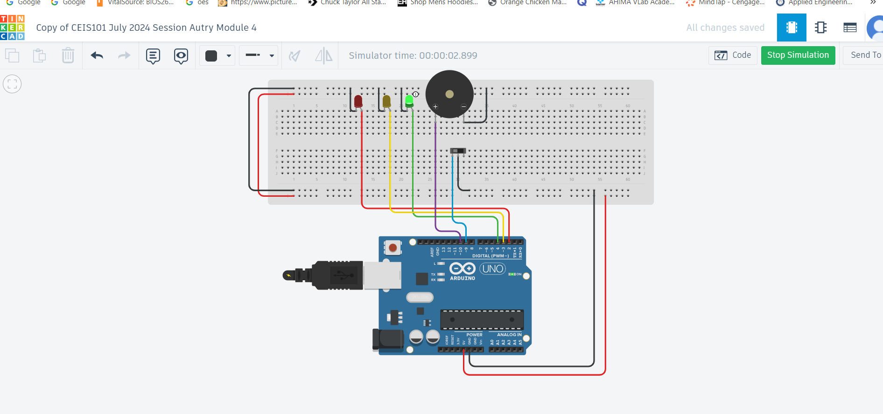
Circuit of door closed with Green LED ON (picture)

Slide 13
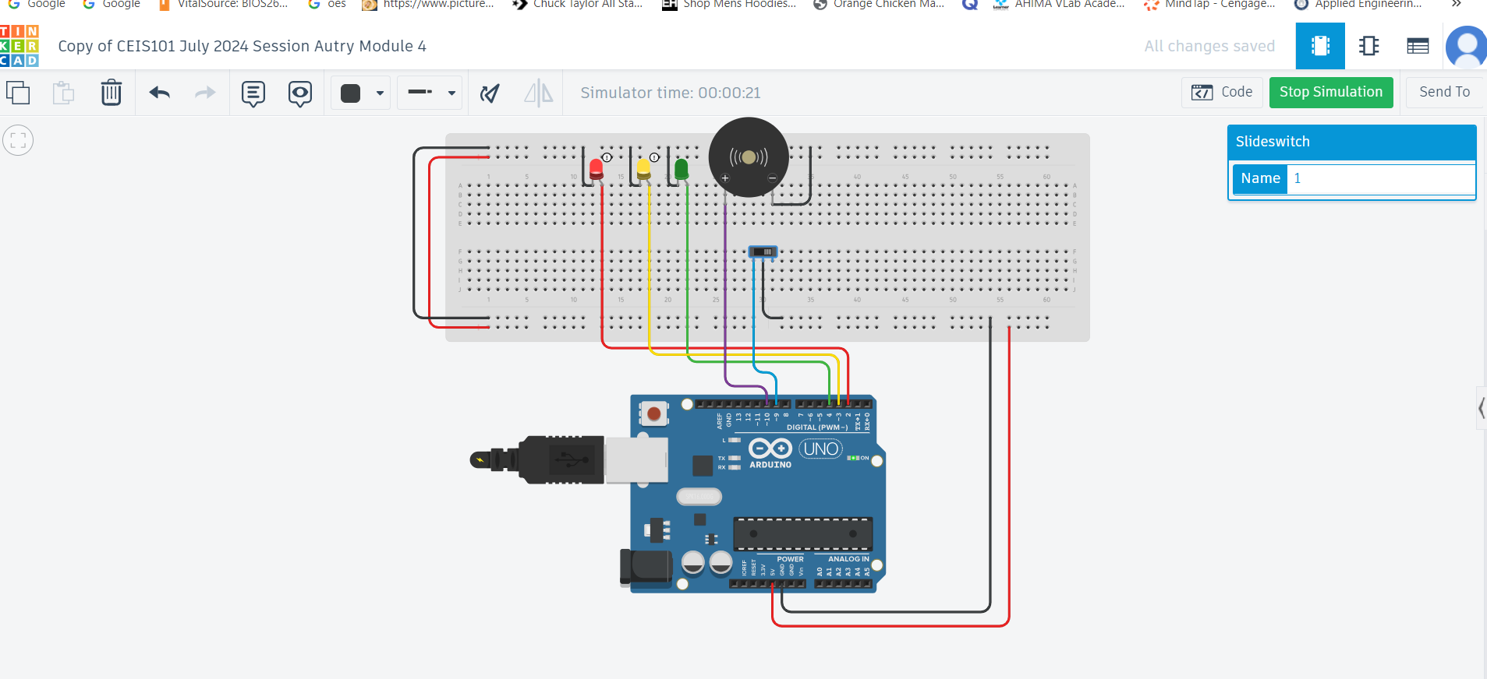
Circuit of door open with Green LED OFF (picture)

Slide 14
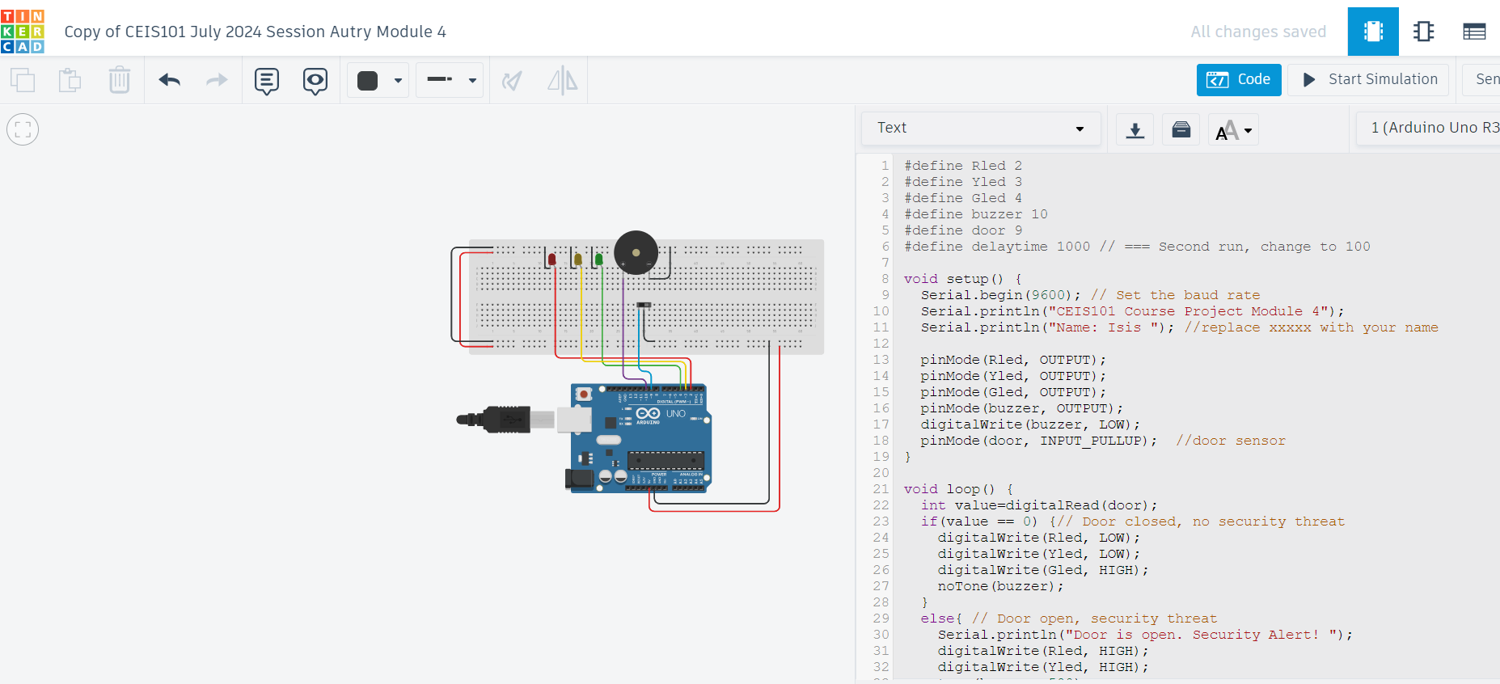
Arduino Code (screenshot)

Slide 15
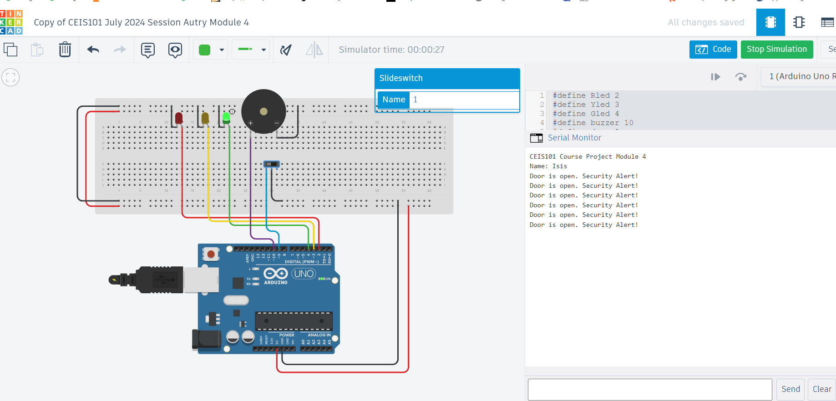
Serial Monitor (screenshot)

Slide 16
CEIS101
Module 5
Adding Distance Sensor to Smart Home System
and Conducting Data Analysis

Slide 17
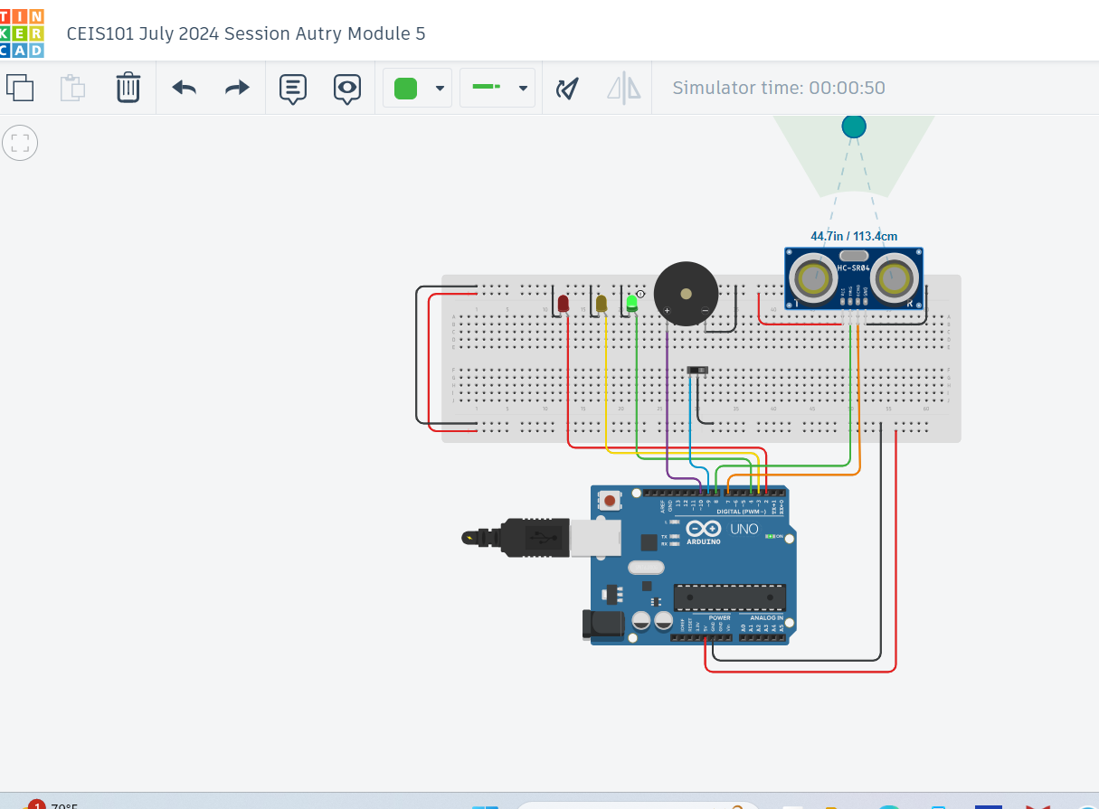
Circuit with green LED on (picture)

Slide 18
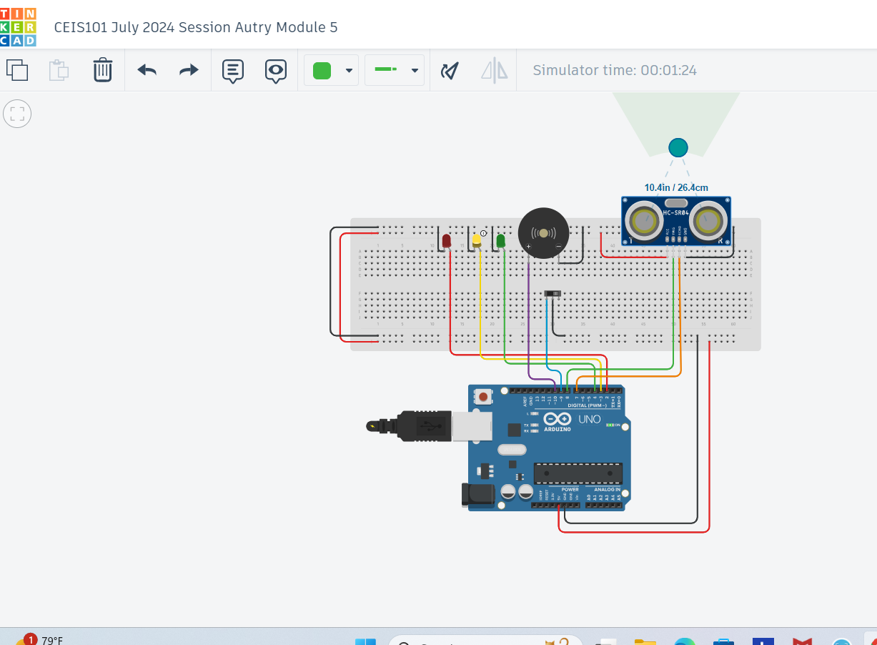
Circuit with yellow LED on (picture)

Slide 19

Circuit with red LED on (picture)

Slide 20
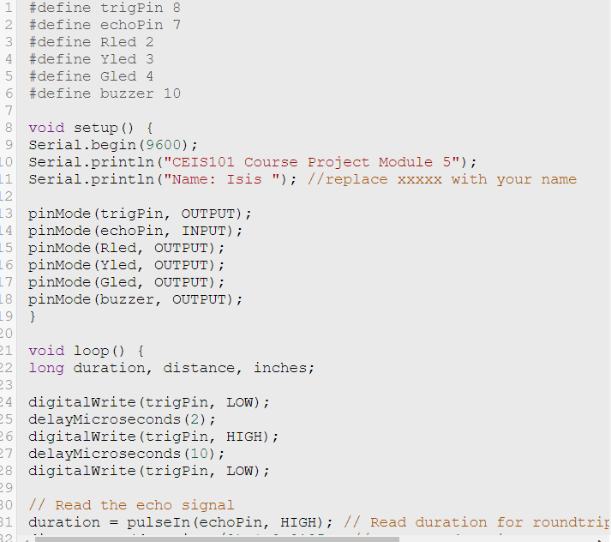
Arduino Code (screenshot)

Slide 21
Plot of data (graph from Excel)

Slide 22
CEIS101
Module 6
Adding Automated Light to Smart Home System

Slide 23
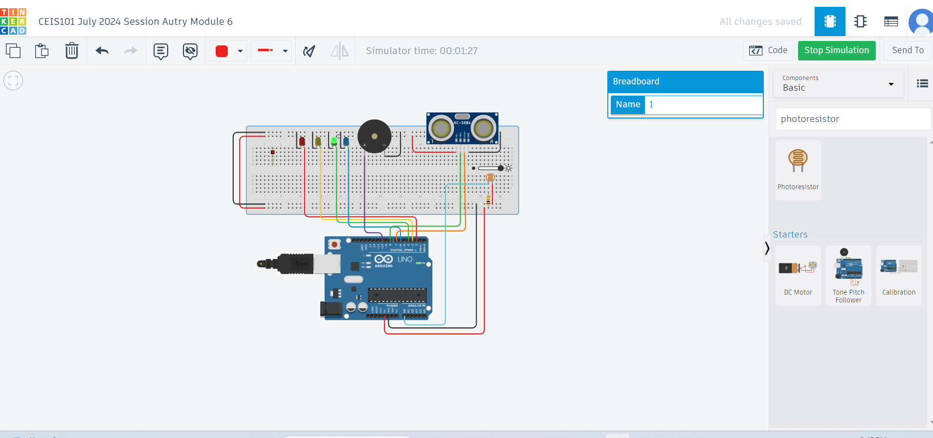
Circuit with automated LED off (picture)

Slide 24
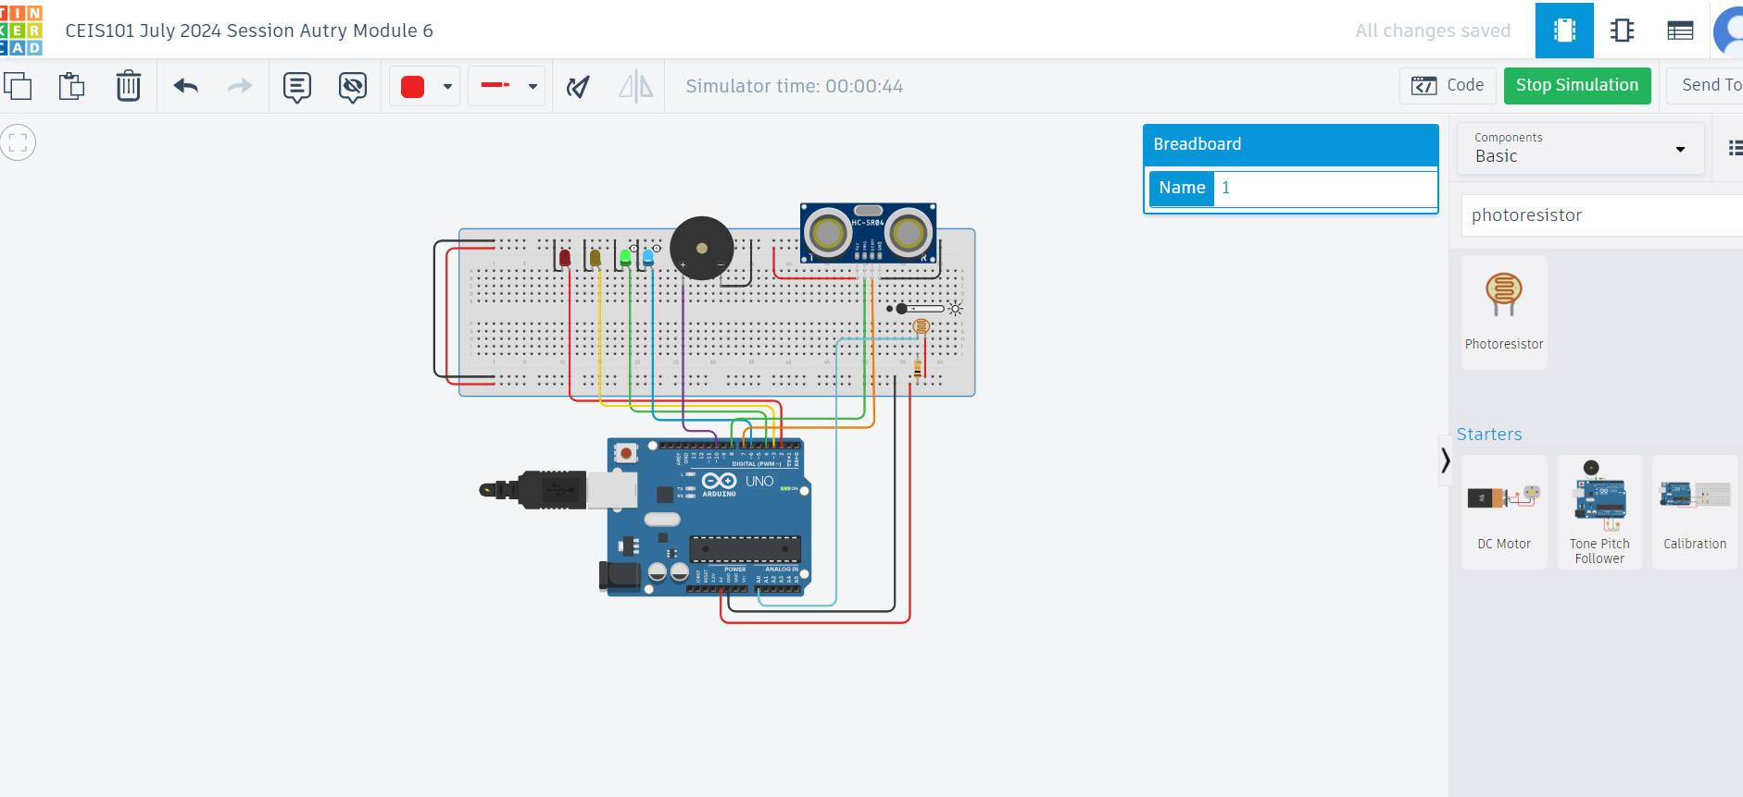
Circuit with automated LED on (picture)

Slide 25
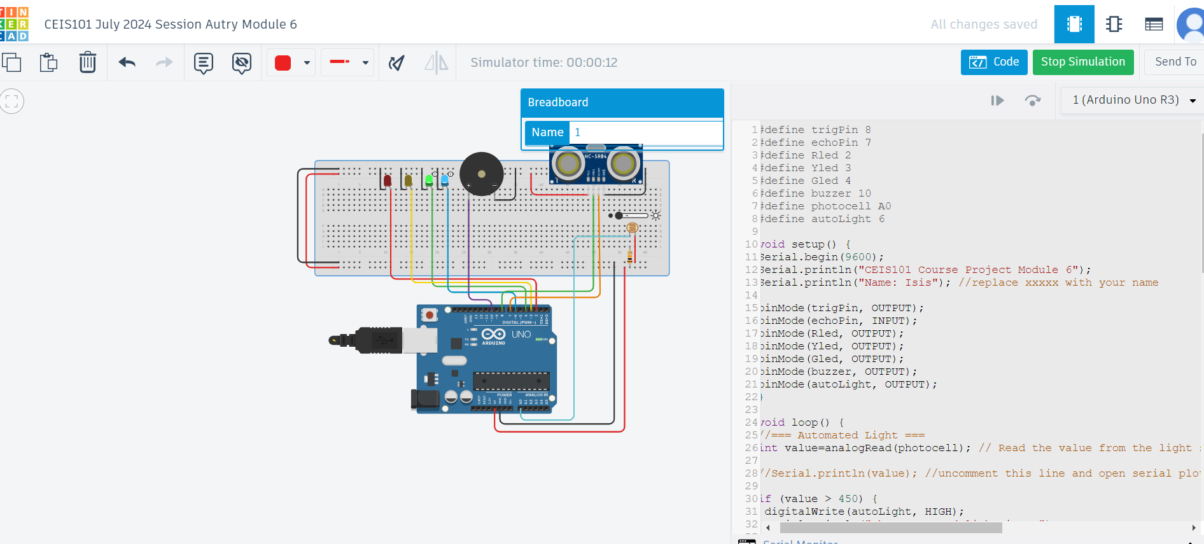
Arduino Code (screenshot)

Slide 26
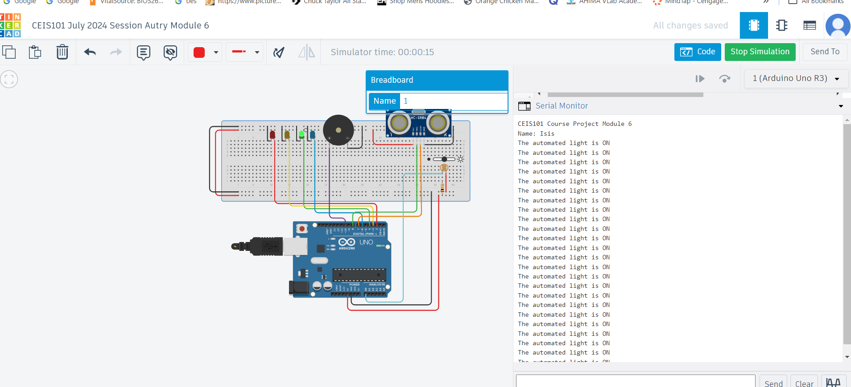
Serial Monitor (screenshot)

Slide 27
Challenges/Lessons Learned
A challenge that I have faced during this project is I the overall placement of the components used. I overcame this by continuously moving parts around and clicking around Tinkercad. It took some time getting used to moving the pieces around and getting comfortable with placing them. Another challenge I had was the programming sometimes I would copy and paste it wrong and then it wouldn’t work properly and I had to find the error and fix it. I learned how to make my own protype as well as looking at how to coding part is set up.

Slide 28
Career Skills
In this course I was able to go over the basics of Technology and the difference I could make in the future to impact it. I was also able to get a working knowledge of how coding works as well as being able to work on my own prototype to get some experience. These skills will help me advanced in the future as they are skills I can put on my resume for experience.

Slide 29
Conclusion
In conclusion this project was helpful and eye opening on making a prototype, as well as the amount of time and effort that can go into it. I enjoyed doing this project and expanding my knowledge on technology and how they work. I would recommend this class/project to anyone starting out and wanting to learn and get a feel of the world of technology.

Slide 30
References
For This course we used Tinkercad to build the prototype in a virtual setting. The codding was provided to us through our course project guide to be able to get it working properly.

